Slide 1
Python Beginner Crash Course
Muhammad Ashfaq

Slide 2
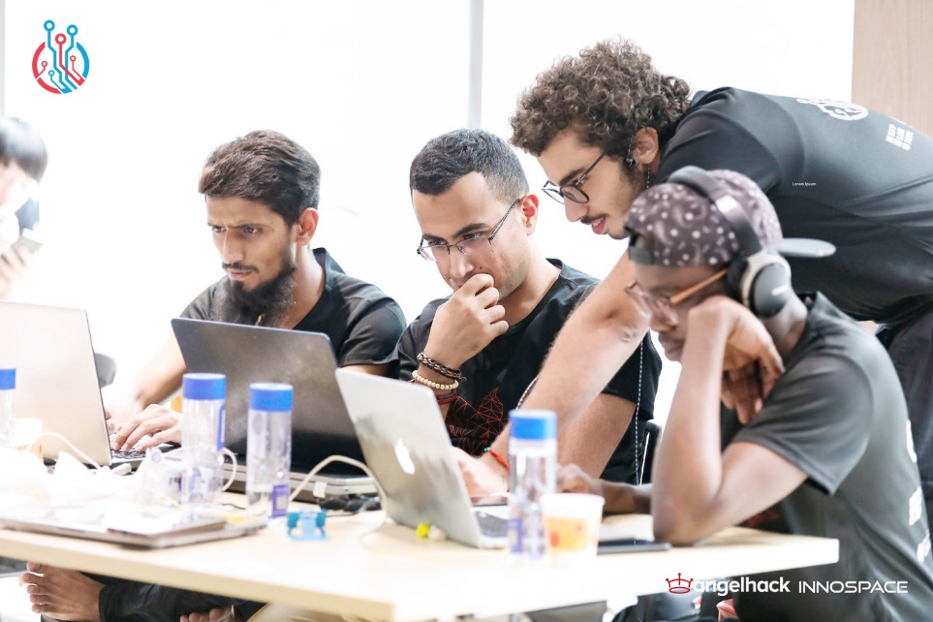
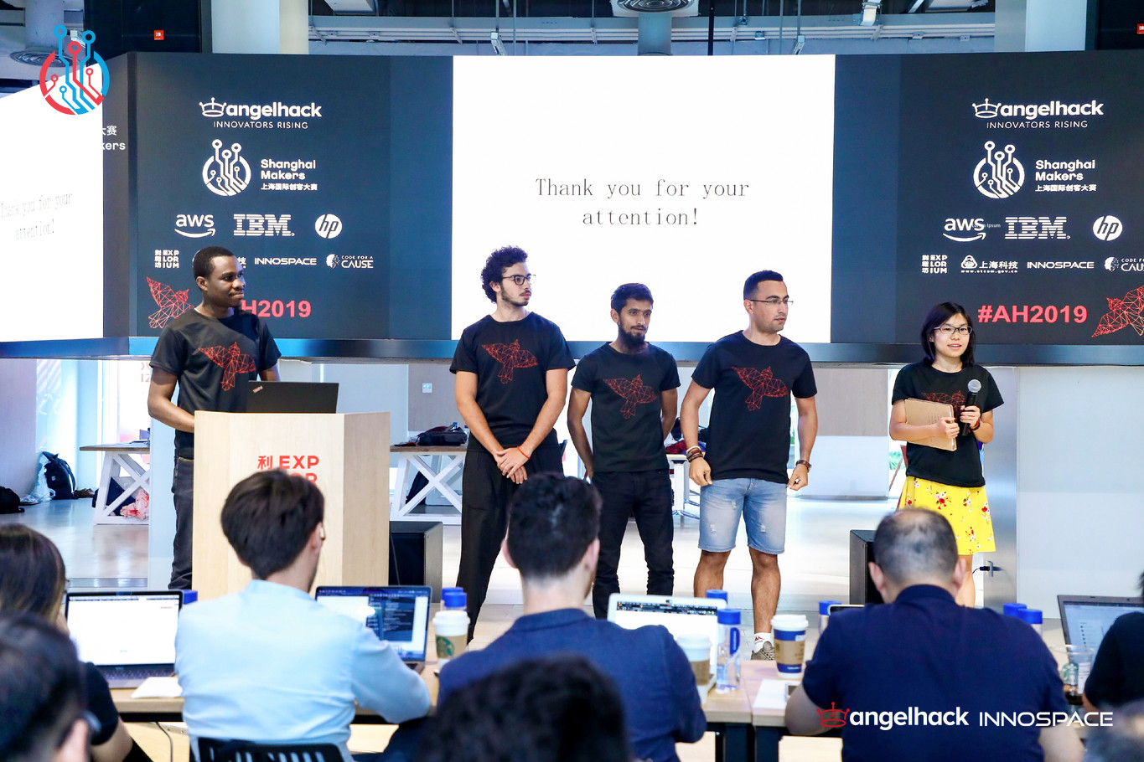
About Me
Trust Me: I’m a Programmer
Major: Computer Science and Technology
Research: Software Testing
Programing Languages: Python, Java, C++

Slide 3
Contents
Introduction to Python
Real World Application in Python
Data Science Using Python
Machine Learning in Python
Don’t ask question at the end of workshop!
Ask question instantly!
Feel free to interrupt at anytime

Slide 4
Introduction to Python
A Beginner Introduction, what is python, why python

Slide 5
Introduction to Python
What is Python?
Why Python?
A programing language
What is a programing language?
Language that is understandable by computer. We tell computer what to do
Because it is easy!
If someone thinks python is difficult, maybe he has not come across with java or c++.
General Purpose Programing Language: We can do everything in python.
Software Development, Machine Learning, Data Science, Data Processing, Statistical Analysis etc.

Slide 6
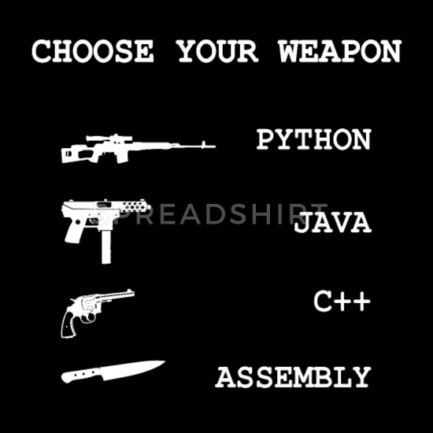
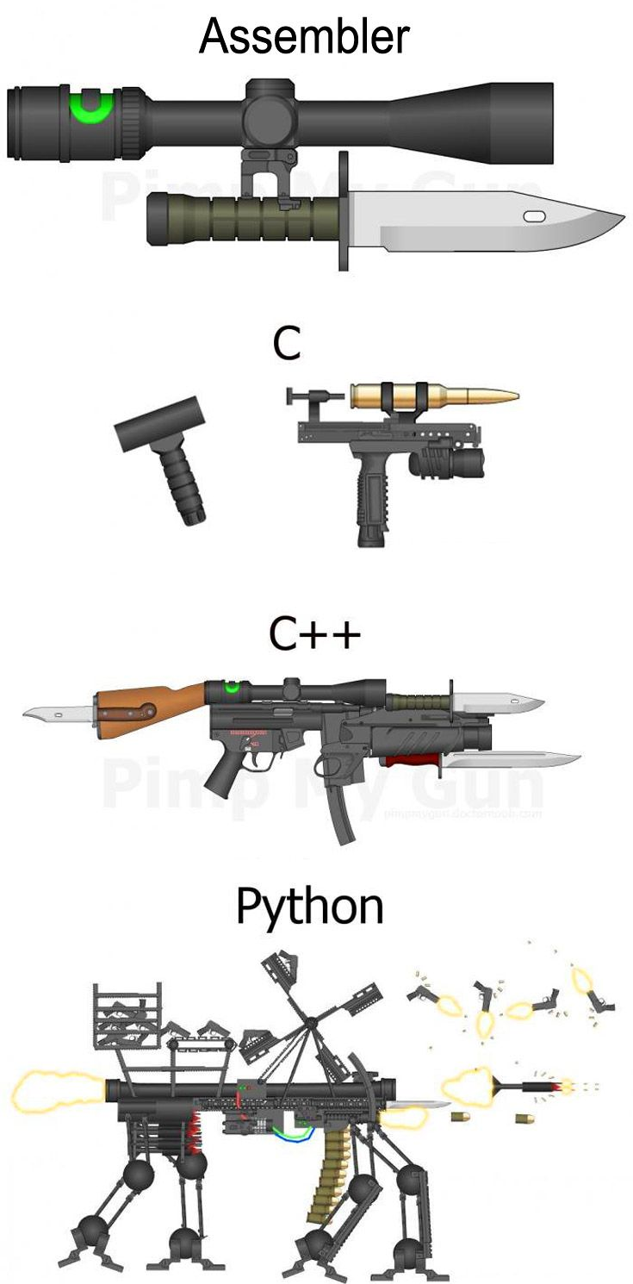

Slide 7
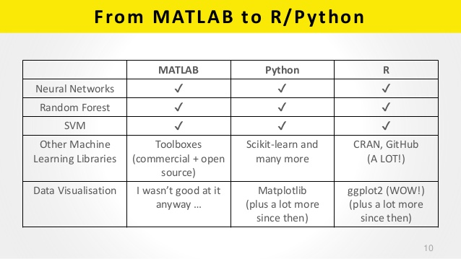
Python vs Matlab vs R
Matlab and R are not proper programing languages!

Slide 8
Real World Application
Installation of python, “Hello World” Using Python

Slide 9

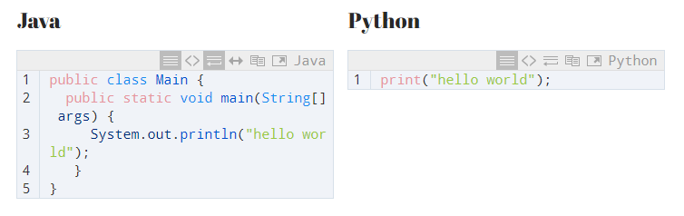
Hello World!

Slide 10

Let’s Make a Calculator!
Enough talk!
Should be better than windows calculator
What we will learn (un-intentionally):
Data Types
variables
Reading Input
Writing Output
Control flow structures
Debugging
Crash course

Slide 11
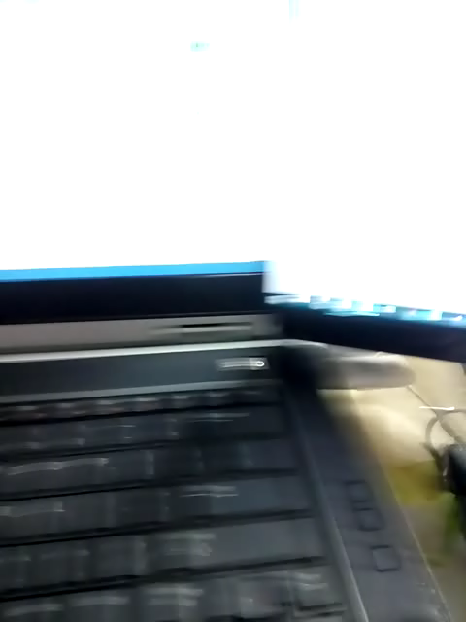
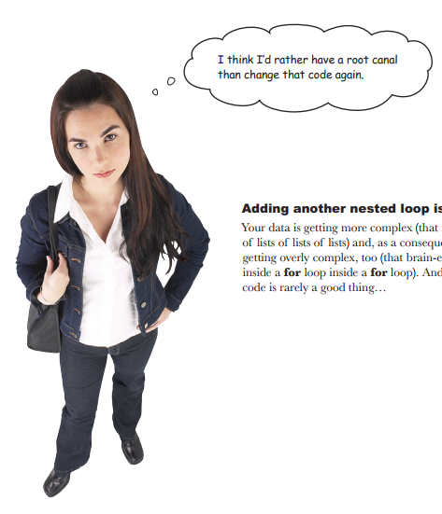
But you said our calculator is better
than windows calculator

Slide 12
Data Science in Python
Data Science: “Understanding of data”. “Getting meaningful results from data”

Slide 13
Data Science Using Python
What we will learn (un-intentionally):
Understanding Data
Statistical Tests on data
Data visualization
Box Plots
Histograms
Matrix Plots

Slide 14

First Machine Learning Project in Python

Slide 15
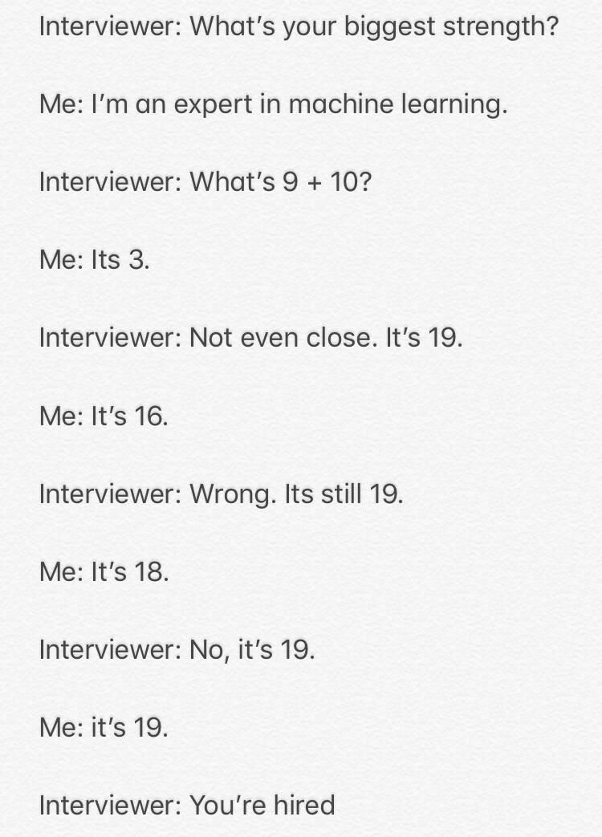
What is Machine Learning
Learning from data instead of logical thinking

Slide 16
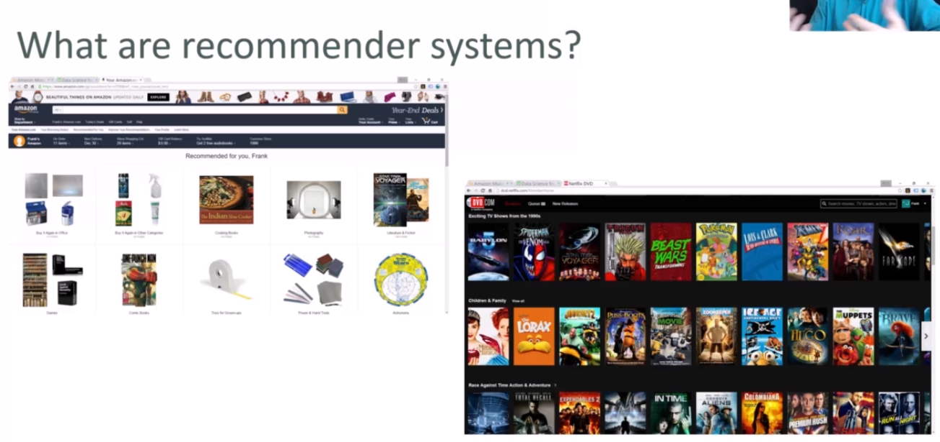

Slide 17
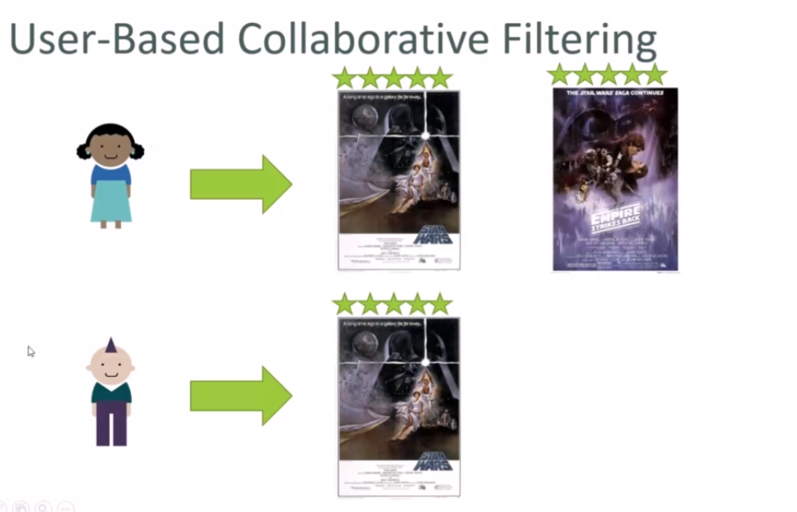

Slide 18
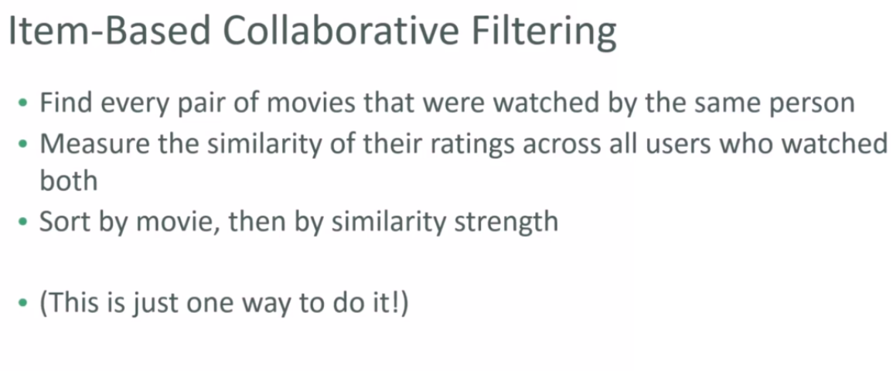

Slide 19
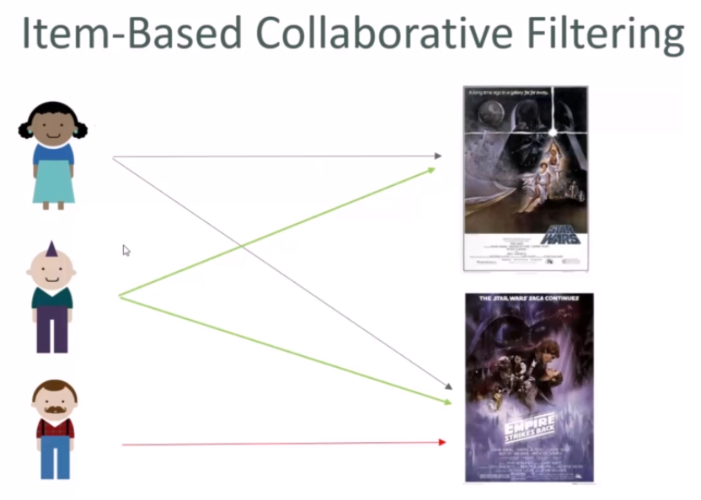

Slide 20
Thank You!

